Slide 1
Lecture 12 – Generative Adversarial Networks
Prof. André Gustavo Hochuli
gustavo.hochuli@pucpr.br
aghochuli@ppgia.pucpr.br
Notes:
Prof. André Hochuli

Slide 2
Topics
Review of Lecture 11 – Image Segmentation
Object Segmentation (Bounding Box Level)
Instance / Semantic Segmentation (Pixel Level)
Generative Adversarial Networks
DCGAN
PIX2PIX
Practice
Computer Vision - Prof. André Hochuli
Lecture 12
Notes:
Prof. André Hochuli

Slide 3
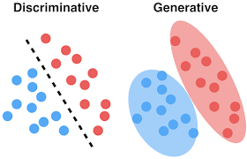
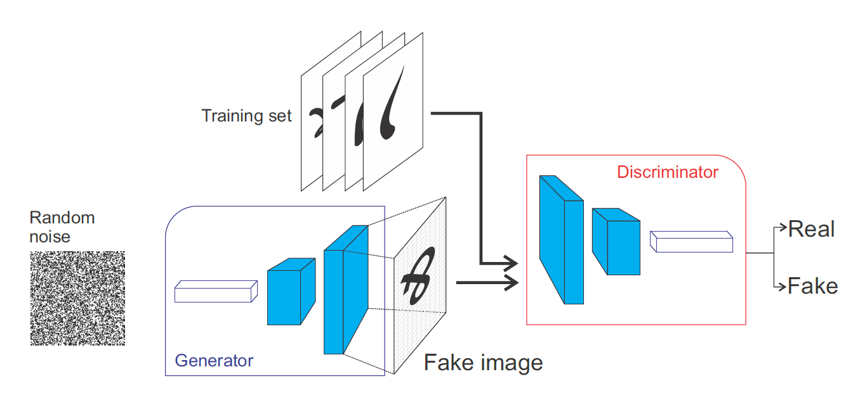
Generative Adversarial Networks (GAN’s)
Generator: Noise → Data
Discriminator: Classification
Computer Vision - Prof. André Hochuli
Lecture 12
Notes:
Prof. André Hochuli

Slide 4
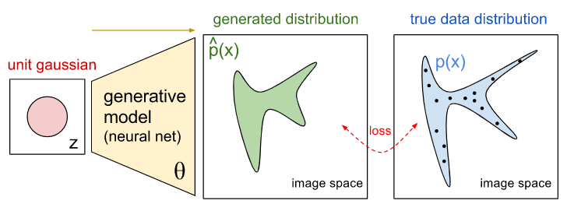
Generative Model
Learns data distribution
Computer Vision - Prof. André Hochuli
Lecture 12
Notes:
Prof. André Hochuli

Slide 5
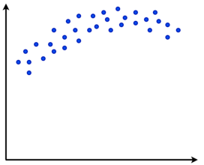
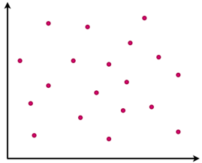
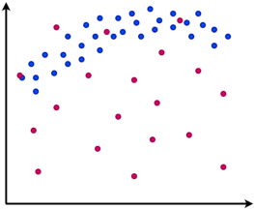
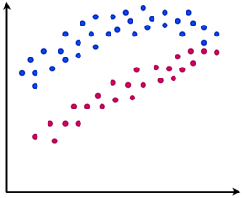
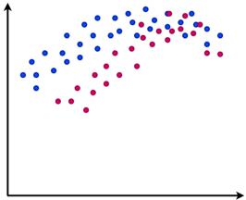
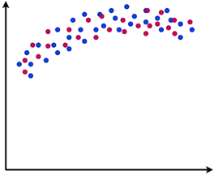
Generative Model
Real
Fake
Training
Computer Vision - Prof. André Hochuli
Lecture 12
Notes:
Prof. André Hochuli

Slide 6
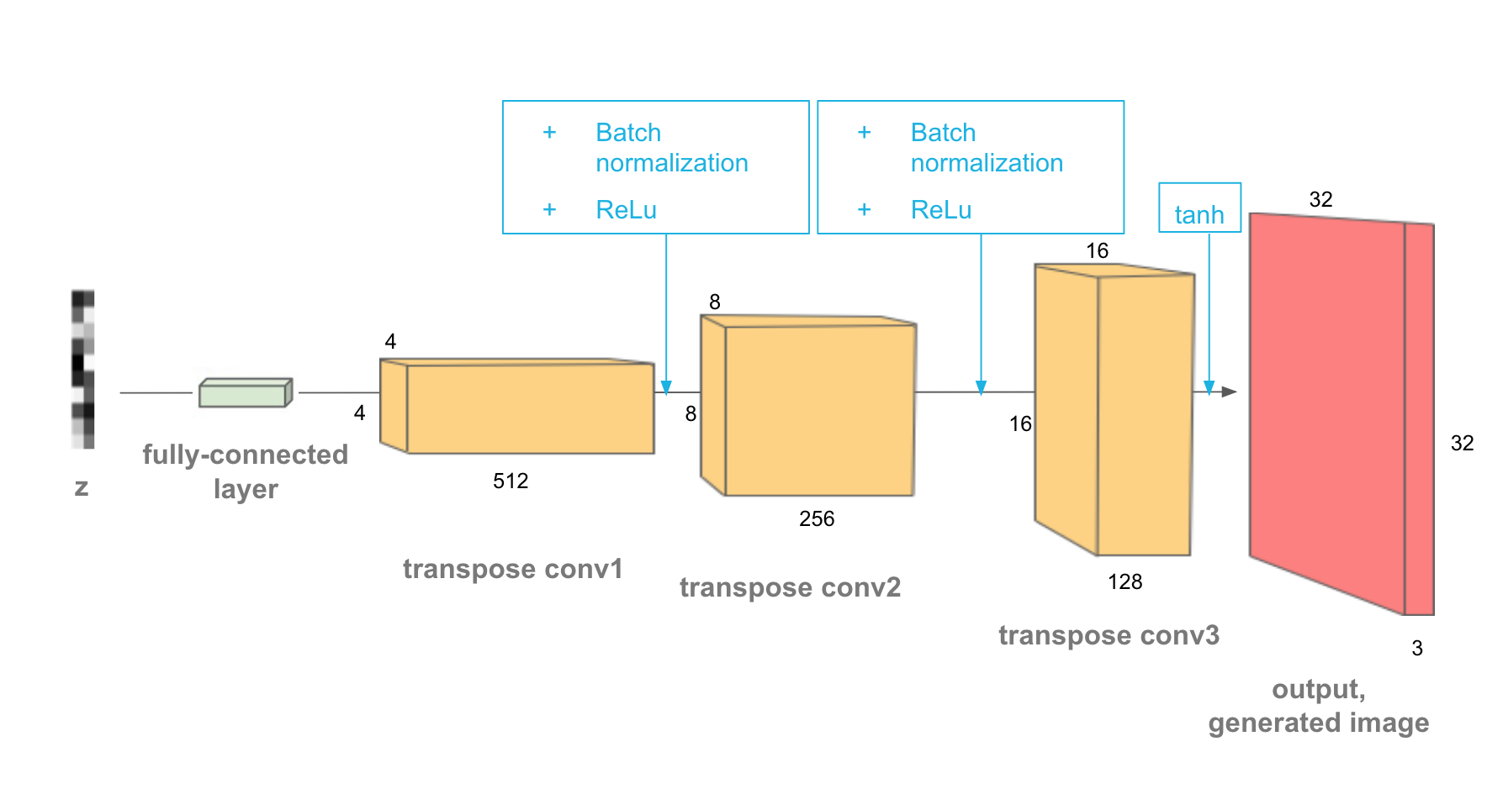
Deep Generative Model
De-Convolutional Layers (upsampling)
Noise to Fake Image
Computer Vision - Prof. André Hochuli
Lecture 12
Notes:
Prof. André Hochuli

Slide 7
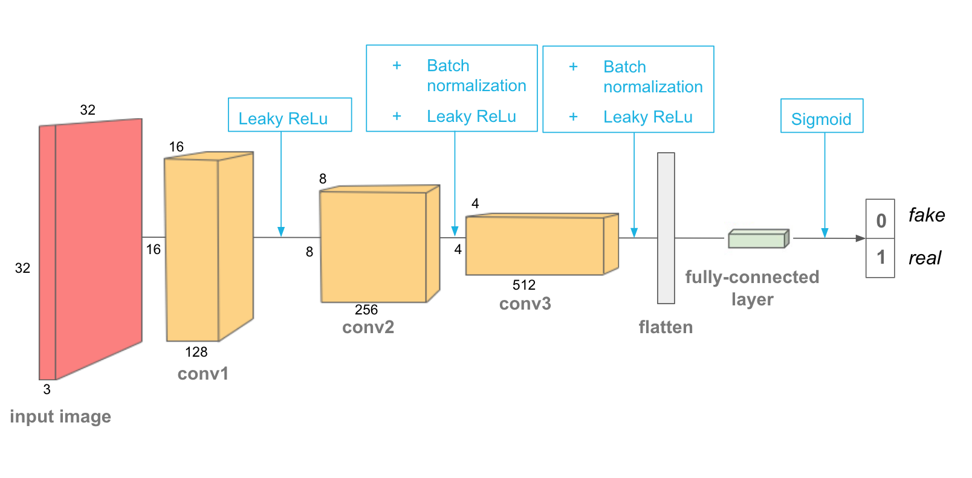
Discriminator Model
Classification: Fake or Real
CNN
Computer Vision - Prof. André Hochuli
Lecture 12
Notes:
Prof. André Hochuli

Slide 8
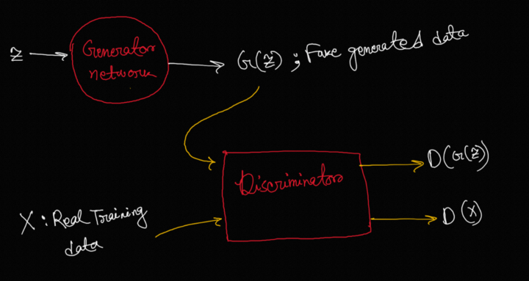
Adversarial Training
Adversarial Loss (Min-Max)
Minimize Generator
Maximize Discriminator
Computer Vision - Prof. André Hochuli
Lecture 12
Notes:
Prof. André Hochuli

Slide 9
Let’s Code
LINK: Lecture_12-DCGAN.ipynb
Computer Vision - Prof. André Hochuli
Lecture 12
Notes:
Prof. André Hochuli

Slide 10
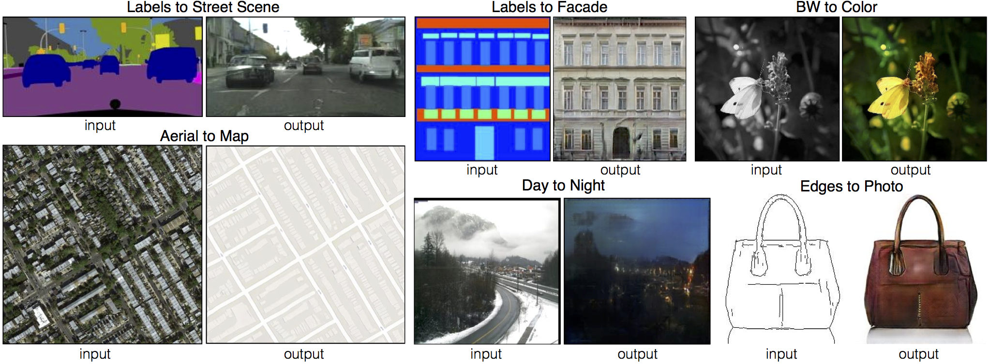
Pix2Pix
Image-Translation
Computer Vision - Prof. André Hochuli
Lecture 12
Notes:
Prof. André Hochuli

Slide 11
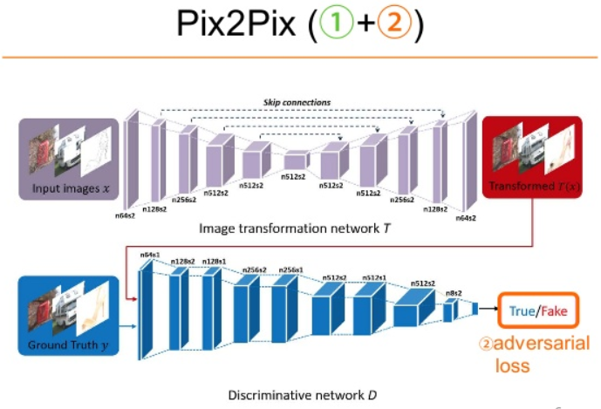
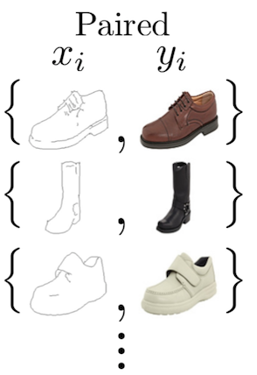
Pix2Pix
Generative Model: Encoder-Decoder Architecture (i.e U-Net)
Paired Annotated Dataset
Computer Vision - Prof. André Hochuli
Lecture 12
Notes:
Prof. André Hochuli

Slide 12
Let’s Code
LINK: Lecture_12-pix2pix.ipynb
Computer Vision - Prof. André Hochuli
Lecture 12
Notes:
Prof. André Hochuli

Slide 13
Course Final Remarks
12 Lectures / Topics
Image Processing
Image Classification
Feature Extraction
Shallow Classification
Deep Learning
Classification
Segmentation
GANs
04 assessment tasks
License Plate Segmentation
Simpsons Classification (Shallow Based Models)
Simpsons Classification (CNN Based)
Simpsons Fake (GANs based)
Computer Vision - Prof. André Hochuli
Lecture 12
Notes:
Prof. André Hochuli

